Slide 1
Water Infrastructure Needs
Thursday, October 6, 2022

Slide 2
Who We Are
SCWC is a non-profit, nonpartisan public education partnership with a membership of about 200 spanning Los Angeles, Orange, San Diego, San Bernardino, Riverside, Ventura, Kern and Imperial counties.
County governments are a cornerstone of our membership because of the integral role they place in infrastructure for community development.

Slide 3
Current State Priorities
Urban conservation
Intensify environmental and regulatory mandates
Shift water supply burdens to local agencies
Demand affordability despite increasing costs
According to a recent PPIC poll, “drought remains the dominant environmental issue for Californians.” Just as, nearly 70 percent “don’t feel that government is doing enough to combat the drought.”
According to a recent PPIC poll, “drought remains the dominant environmental issue for Californians.” Just as important, a majority of Californians, nearly 70 percent “don’t feel that government is doing enough to combat the drought.”

Slide 4
Governor Newsom’s New Water Supply Plan
Supportive sentiment
Great step forward
Applaud leadership, recognition of urgency and need
But we need continued work and follow-through

Slide 5
Agriculture Hit Hard
0% allocation on Central Valley Project and 5% on State Water Project in 2022
$1.7 billion revenue loss
14,600 jobs lost
395,000 acres left dry and unplanted
Food security

Slide 6
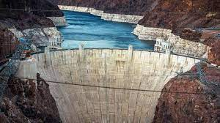
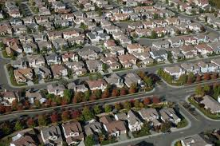
Urban Losses
State Water Project cutback from 5M acre-feet to 250,000 AF
SoCal loss of 1.9M AF
Colorado River cuts coming
Recycled water effectively committed
State needs roughly 20M AF of new supply – where do we get it?

Slide 7
Solutions
More surface and
groundwater storage
New supply including investments in local water infrastructure, such as groundwater recharge, desalination, and recycling
Improved inter-regional and
local conveyance
Creative regulatory solutions such as the voluntary agreements

Slide 8
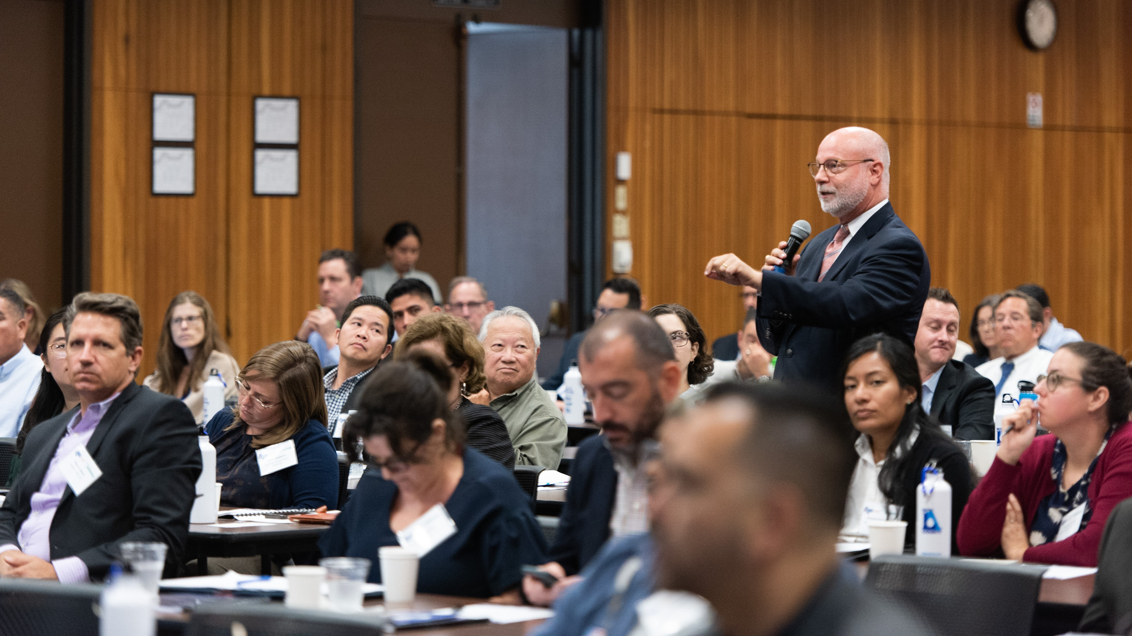
Major Initiatives
Conveyance
Stormwater
Recycled Water
Water Quality Regulations
Water and Energy Efficiency
Water Affordability

Slide 9
Thank you

